Slide 1
Regression-based Classification
UIUC ECON 490: Applied Machine Learning in Economics

Slide 2
Classification and LPM
Quality vs. Quantity

Slide 3
Classification
Economic Examples
What major do students choose?
What products do consumers choose?
80/20 sales rule
Homeownership
Labor force participant

Slide 4

Linear Probability Model (LPM)
$$Y=\left\{\begin{matrix}1 & \text{if} \text{a} \text{renter} \\ 0 & \text{if} \text{not} \text{a} \text{renter}\end{matrix}\right.$$
$$Y=α+βX+ε$$
$$Y=p(X)+ε$$
$$p(X)=Pr(Y=1|X)$$
Inference…

Slide 5
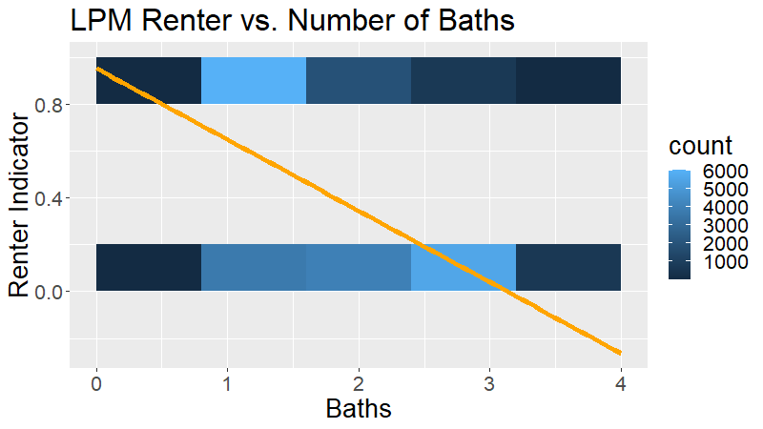
LPM Limitations $y_{i}=α+βbaths_{i}+e_{i}$

Slide 6
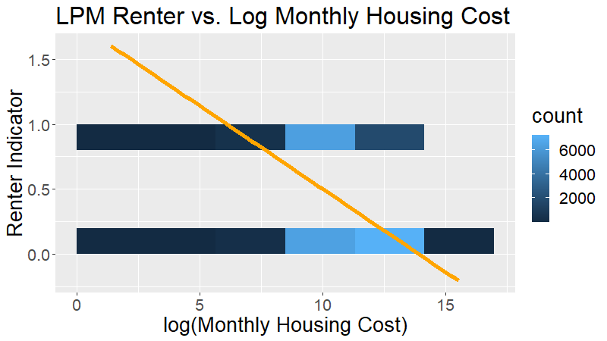
LPM Limitations $y_{i}=α+βlog⁡({cost}_{i})+e_{i}$

Slide 7
Binomial Logistic Regression
A Sigmoid Function

Slide 8
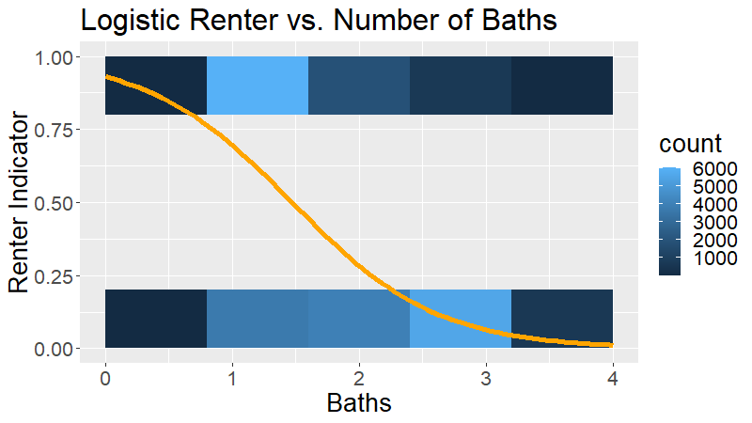
Sigmoid Shapes

Slide 9

Functional Form
$$p(X)=\frac{e^{α+βX}}{1+e^{α+βX}}$$
$$\frac{p(X)}{1−p(X)}=e^{α+βX}$$
$$log\left(\frac{p(X)}{1−p(X)}\right)=α+βX$$

Slide 10
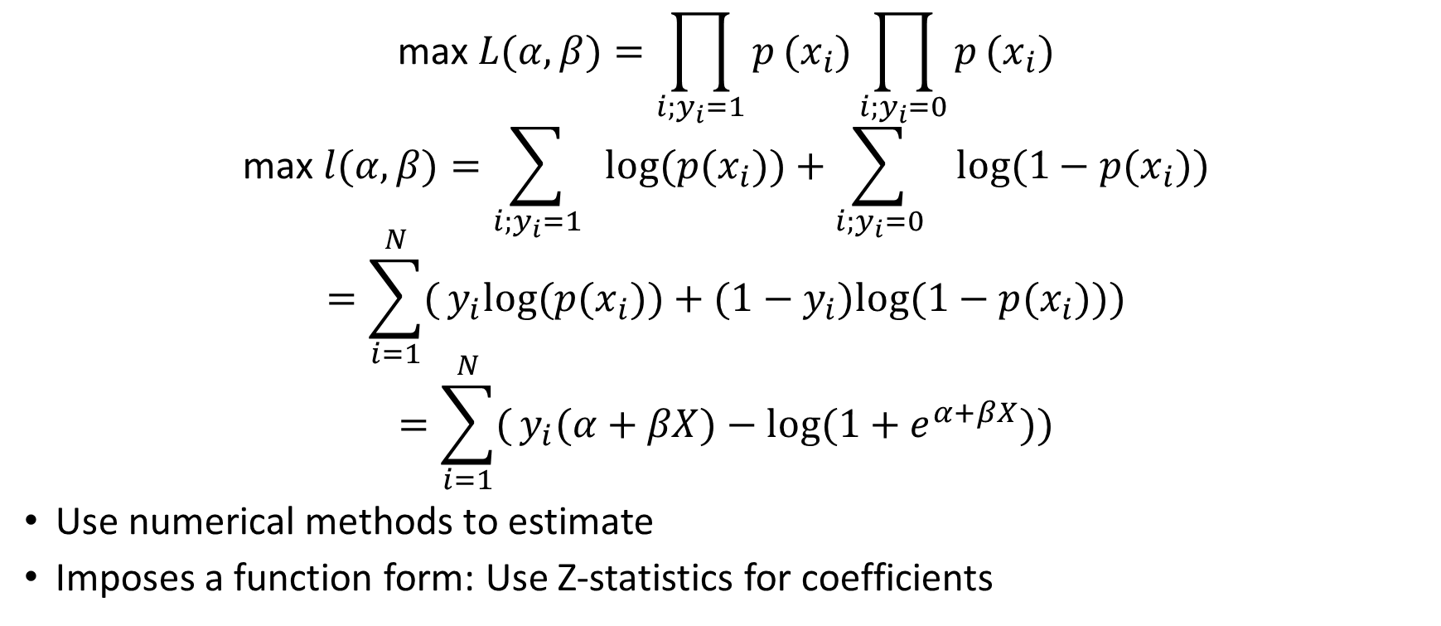
Estimation
$$\text{max} L(α,β)=\prod_{i;y_{i}=1}^{​}{p}(x_{i})\prod_{i;y_{i}=0}^{​}{p}(x_{i})$$
$$\text{max} l(α,β)=\sum_{i;y_{i}=1}^{​}{ }log(p(x_{i}))+\sum_{i;y_{i}=0}^{​}{ }log(1−p(x_{i}))$$
$$=\sum_{i=1}^{N}{(}y_{i}log(p(x_{i}))+(1−y_{i})log(1−p(x_{i})))$$
$$=\sum_{i=1}^{N}{(}y_{i}(α+βX)−log(1+e^{α+βX}))$$
Use numerical methods to estimate
Imposes a function form: Use Z-statistics for coefficients

Slide 11
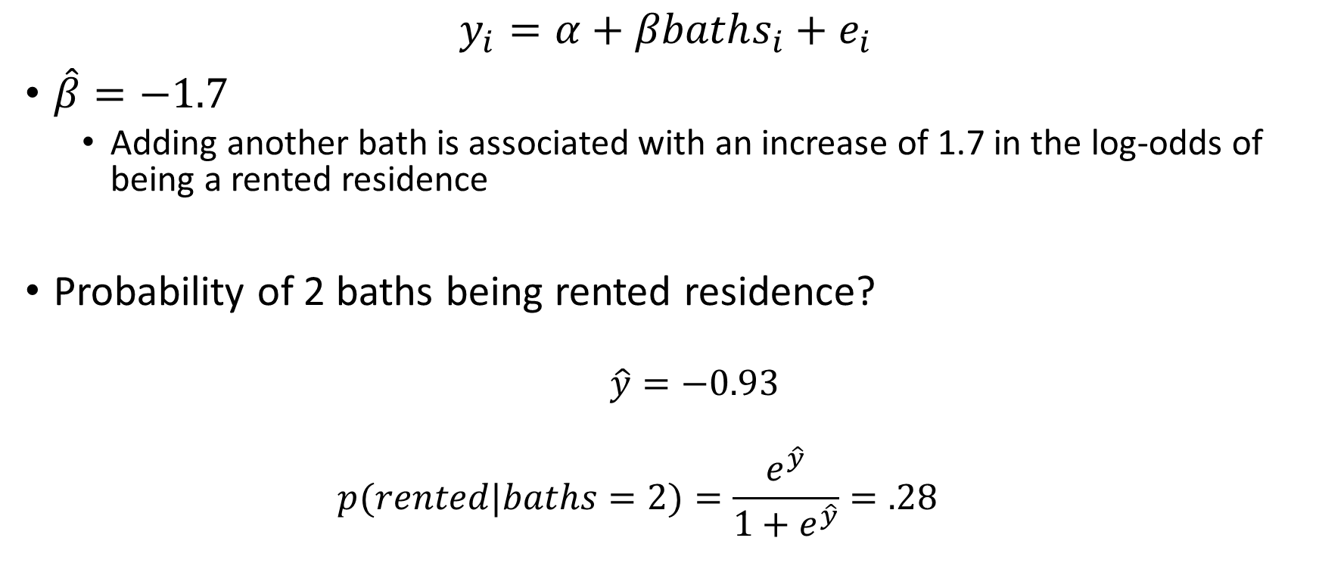
Inference & Prediction
$$y_{i}=α+βbaths_{i}+e_{i}$$
$\hat{β}=−1.7$
Adding another bath is associated with an increase of 1.7 in the log-odds of being a rented residence
Probability of 2 baths being rented residence?
$\hat{y}=−0.93$
$$p(rented|baths=2)=\frac{e^{\hat{y}}}{1+e^{\hat{y}}}=.28$$

Slide 12
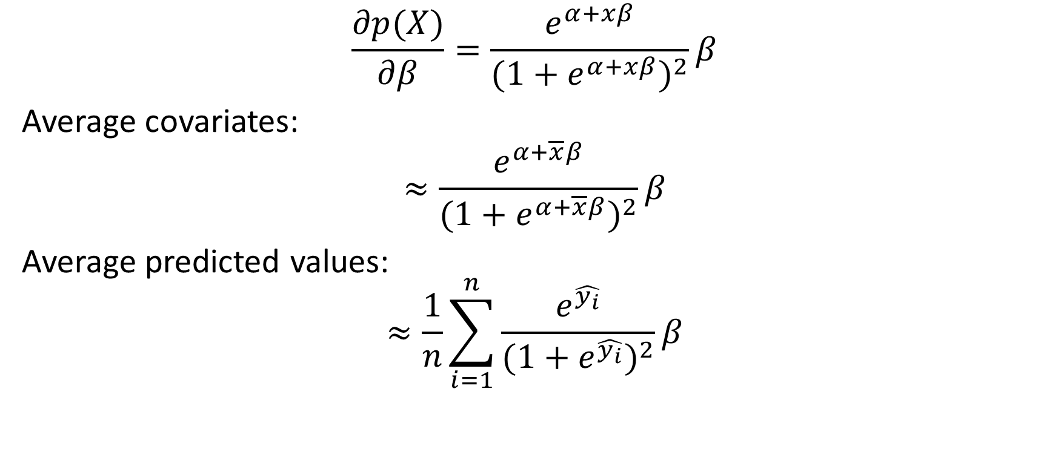
Marginal Effects
$$\frac{∂p(X)}{∂β}=\frac{e^{α+xβ}}{(1+e^{α+xβ})^{2}}β$$
Average covariates:
$$≈\frac{e^{α+\overline{x}β}}{(1+e^{α+\overline{x}β})^{2}}β$$
Average predicted values:
$$≈\frac{1}{n}\sum_{i=1}^{n}{\frac{e^{\hat{y_{i}}}}{(1+e^{\hat{y_{i}}})^{2}}}β$$

Slide 13
A Note On Classifying
Threshold choice:
What if we want to be more confident of identifying renters?

Slide 14
Multinomial Logistic Regression
More Classes

Slide 15

LPM Limitations Part 2
$$Y=\left\{\begin{matrix}1 & \text{apples} \\ 2 & \text{toothpaste} \\ 3 & \text{charcoal}\end{matrix}\right.$$
Uh… what do I do with these extra classes?

Slide 16
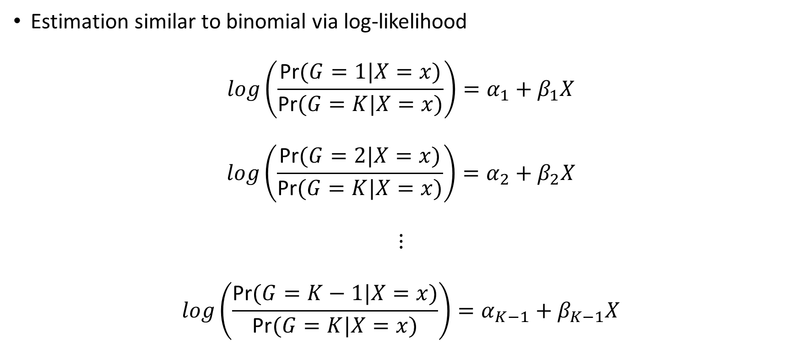
Multinomial Logistic Regression
Estimation similar to binomial via log-likelihood
$$log\left(\frac{\text{Pr}(G=1|X=x)}{\text{Pr}(G=K|X=x)}\right)=α_{1}+β_{1}X$$
$$log\left(\frac{\text{Pr}(G=2|X=x)}{\text{Pr}(G=K|X=x)}\right)=α_{2}+β_{2}X$$
$$⋮$$
$$log\left(\frac{\text{Pr}(G=K−1|X=x)}{\text{Pr}(G=K|X=x)}\right)=α_{K−1}+β_{K−1}X$$

Slide 17

Multinomial Logistic Regression
$$\text{Pr}(G=k|X=x)=\frac{e^{α_{k}+β_{k}x}}{1+\sum_{l=1}^{K−1}{e^{α_{l}+β_{l}x}}}$$
for $k=1,...,K−1$
$$\text{Pr}(G=K|X=x)=\frac{1}{1+\sum_{l=1}^{K−1}{e^{α_{l}+β_{l}x}}}$$

Slide 18

Comparison to Binomial
$$log\left(\frac{\text{Pr}(rented=1|X=x)}{\text{1}\text{− }\text{Pr}(rented=1|X=x)}\right)=α+βX$$
$$log\left(\frac{\text{Pr}(rented=1|X=x)}{\text{Pr}(rented=0|X=x)}\right)=α+βX$$

Slide 19

Inference
If $K=$ toothpaste, $k=$ apples, $β_{k}=2$, and $x=log(wage)$
A one percent increase in wages is associated with an increase in the log odds of apples relative to toothpaste by 2.

Slide 20
To Do
Read
2.2.3
3.5
4.4
4.5
Complete
Lab 4.6.1
Lab 4.6.2

